Slide 1

RAG System Design: Healthcare EHR Chatbot
Ramkumar J
ramkumarj@presidio.com

Slide 2
Use Case Overview: Patient Record Chatbot
Providers often need quick answers from lengthy patient documents
Patient data is stored in scanned PDF forms
Traditional search is inefficient; RAG enables natural language access

Slide 3
System Design Overview
OCR converts scanned PDF to text
Text is chunked and embedded into a vector store
LLM retrieves and answers queries with document context
Chatbot UI serves doctors within EHR
Security & HIPAA Compliance
All PHI processed and stored in HIPAA-eligible AWS services
Data encrypted in transit (TLS) and at rest (SSE-S3 / KMS)
Role-based access control with AWS IAM
VPC endpoints, logging, audit trails, and private subnets

Slide 4

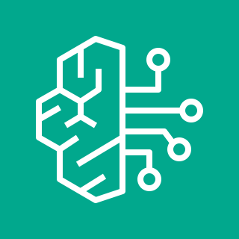




AWS Cloud Components
Amazon Textract: OCR for scanned PDFs
Amazon S3: Store raw and processed patient files
Amazon Bedrock or SageMaker: LLM inference
Amazon OpenSearch or RDS: Metadata store
Amazon VPC & IAM: Secure network and identity boundaries
Amazon Textract
Amazon Bedrock
Amazon Simple Storage Service (Amazon S3)
Amazon OpenSearch Service
Amazon Virtual Private Cloud (Amazon VPC)
AWS Identity and Access Management (IAM)

Slide 5
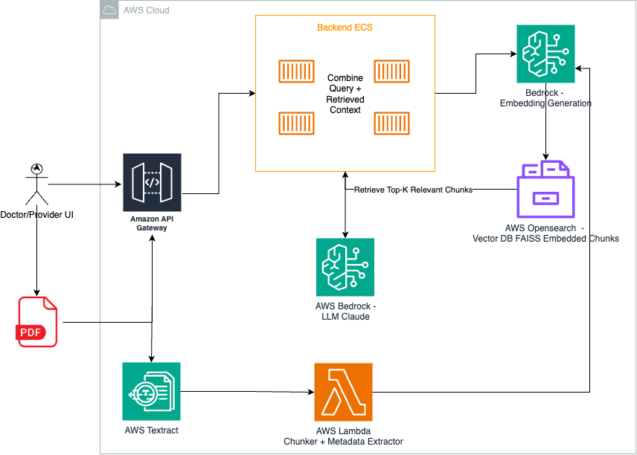

Slide 6
RAG Workflow Summary
1. Upload patient PDFs to S3
2. Textract performs OCR
3. Chunks embedded and indexed in vector DB
4. Provider asks question via UI
5. Top-k chunks retrieved and passed to LLM
6. Generated answer returned in real time

Slide 7

Thank You
Ramkumar J
Senior Engineer, Presidio
ramkumarj@presidio.com

